Slide 1
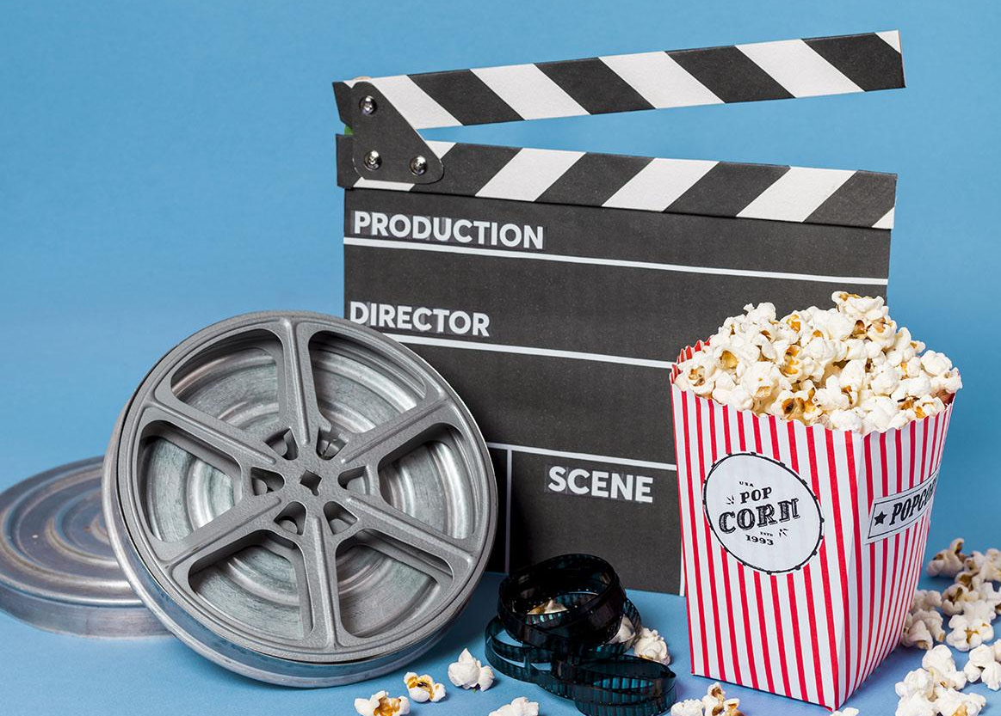
Movie recommended system
Name: Khuong Viet Tai
ID: 19522151

Slide 2
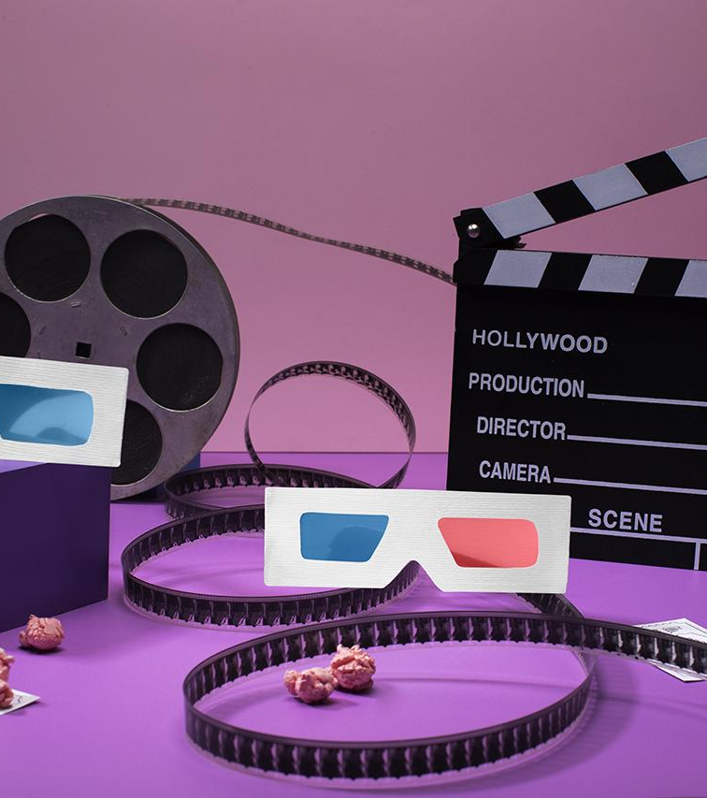
History of cinema
Do you know what helps you make your point clear? Lists like this one:
They’re simple
You can organize your ideas clearly
You’ll never forget to buy milk!
You can replace the image. Just right-click on it and select “Replace image”

Slide 3
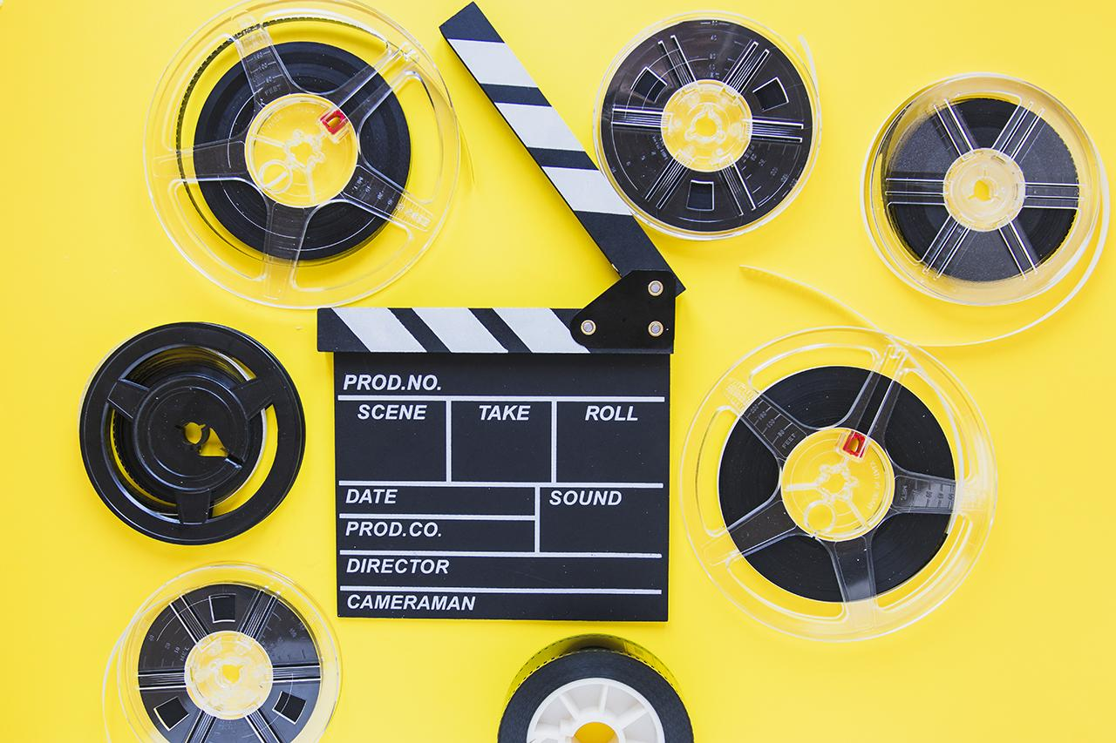
Best movies of this year
Mercury
Mercury is the closest planet to the Sun and the smallest one in the Solar System. This planet’s name has nothing to do with the liquid metal
Venus
Venus has a beautiful name and is the second planet from the Sun. It’s hot and is the second-brightest natural object in the night sky

Slide 4
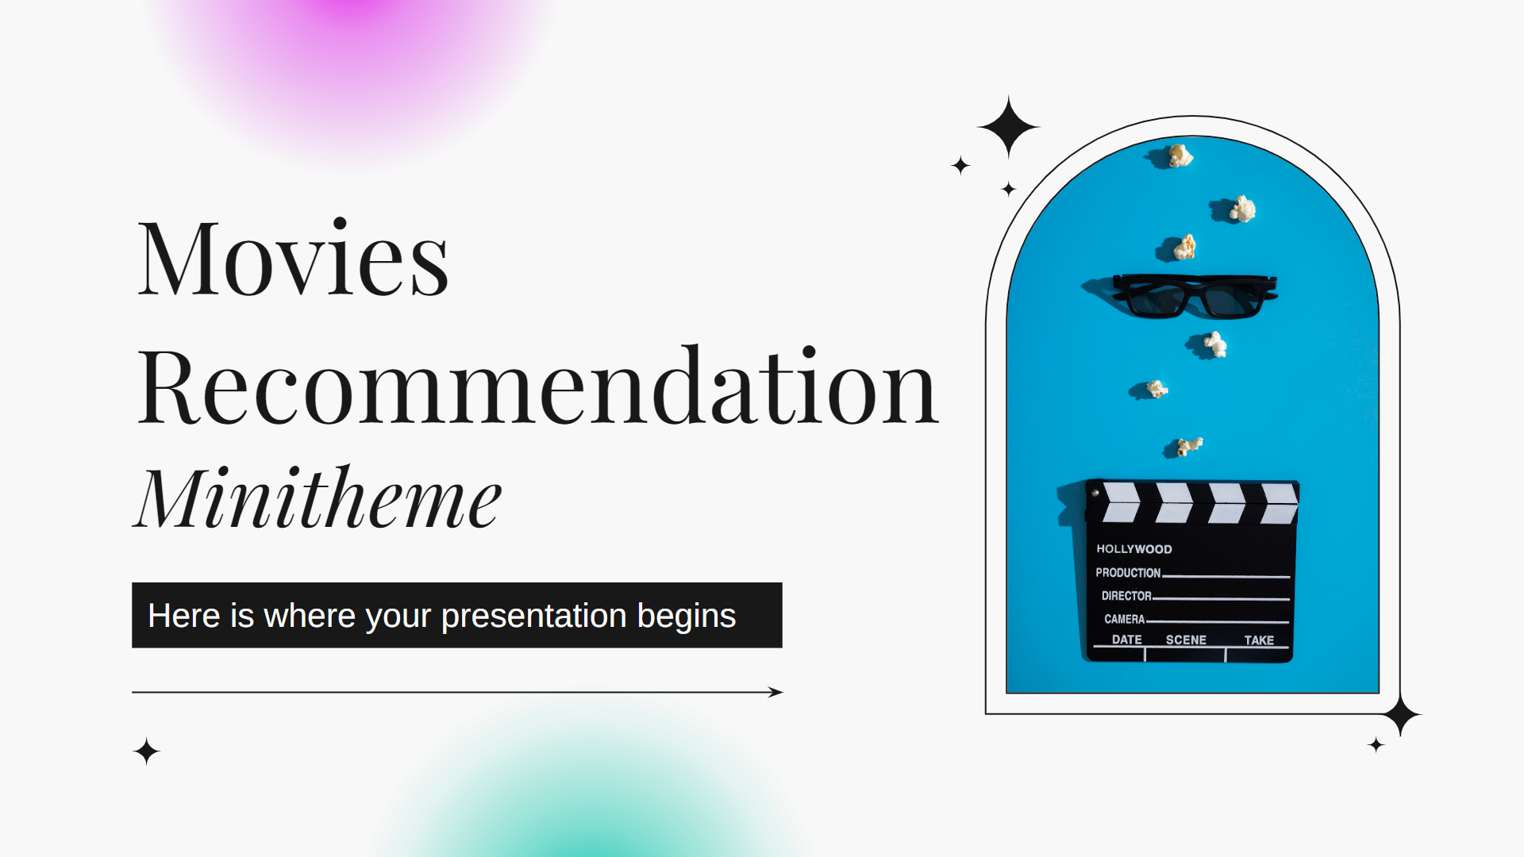
Product demo
You can replace the image on the screen with your own work. Just right-click on it and select “Replace image”

Slide 5
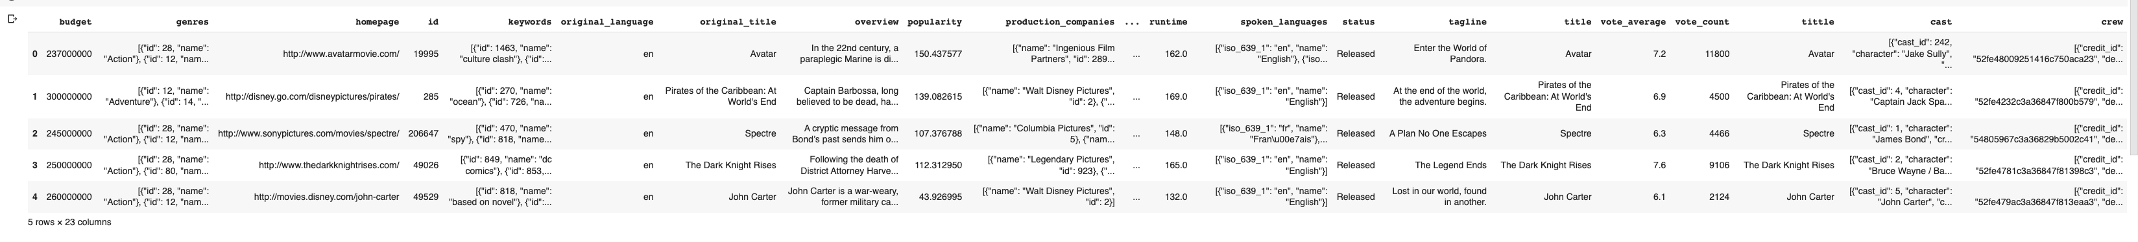
Data set

Slide 6
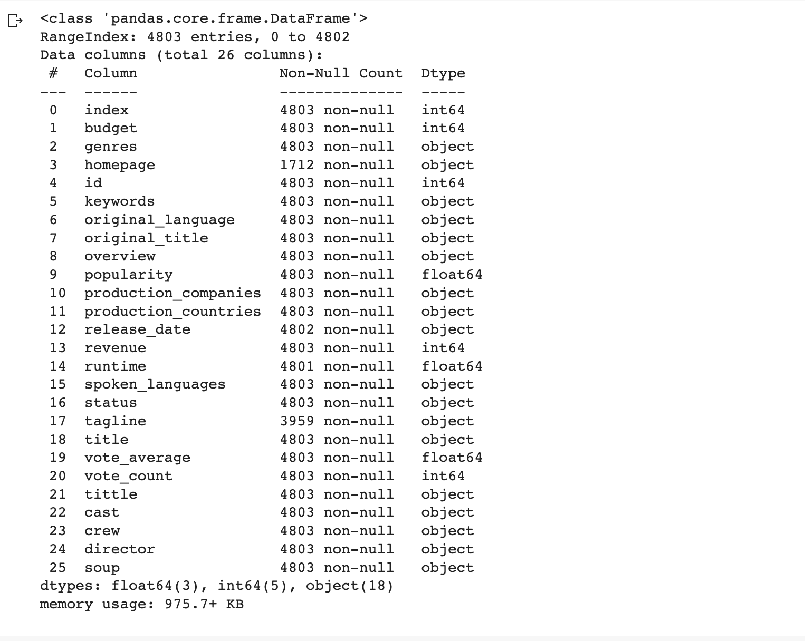
Data info

Slide 7
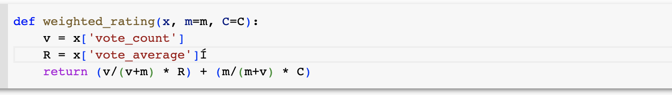
Cacula rating

Slide 8
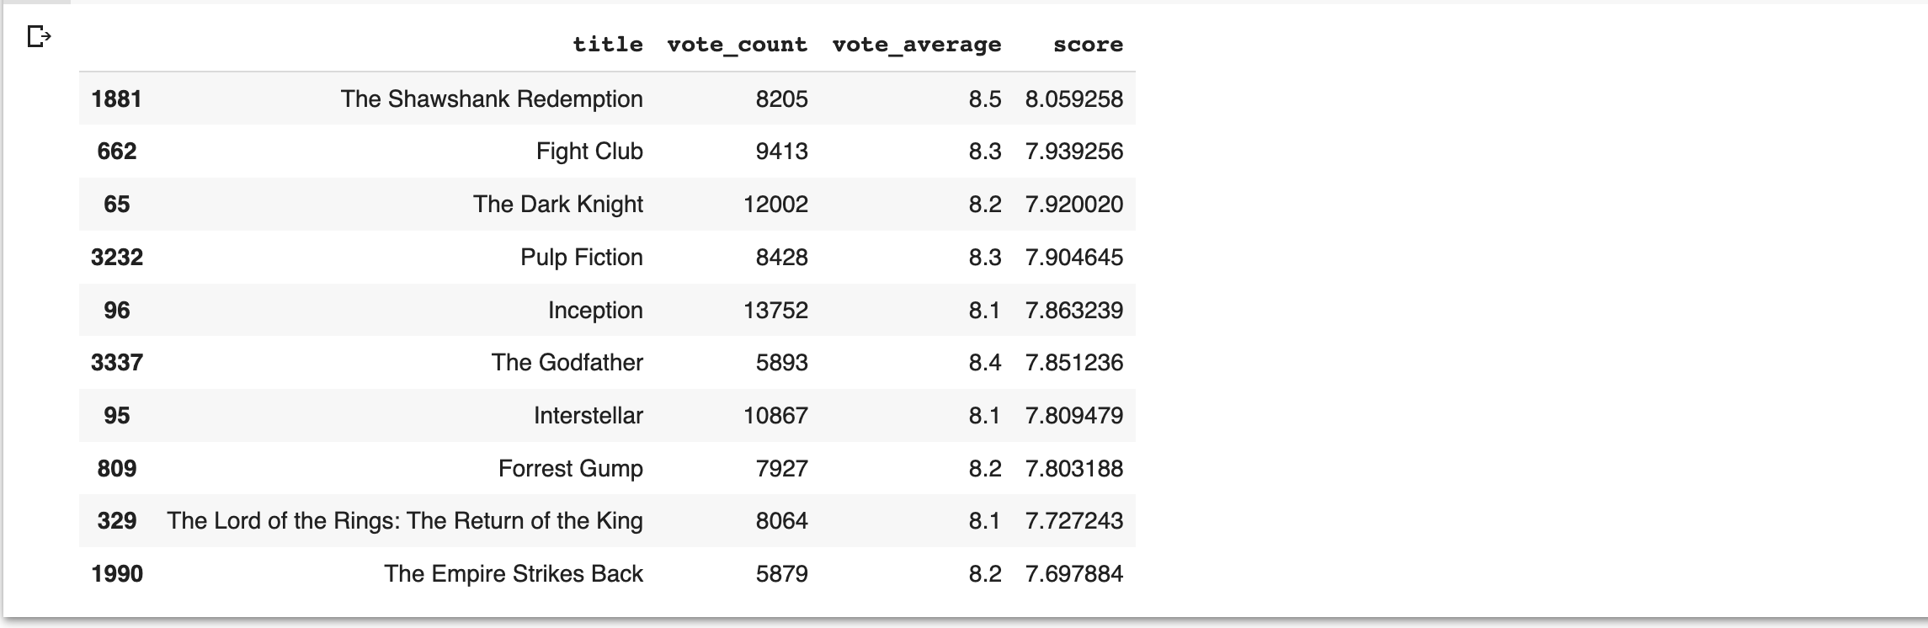
The top 15 movie

Slide 9
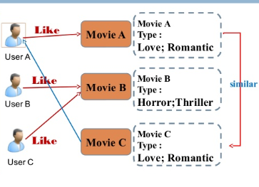
Content Based Filtering

Slide 10
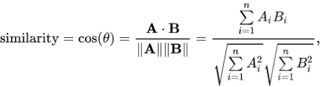
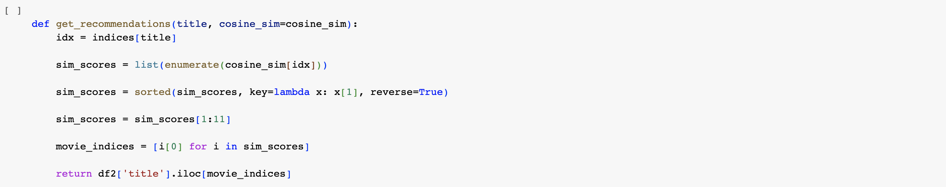
Mathematically

Slide 11
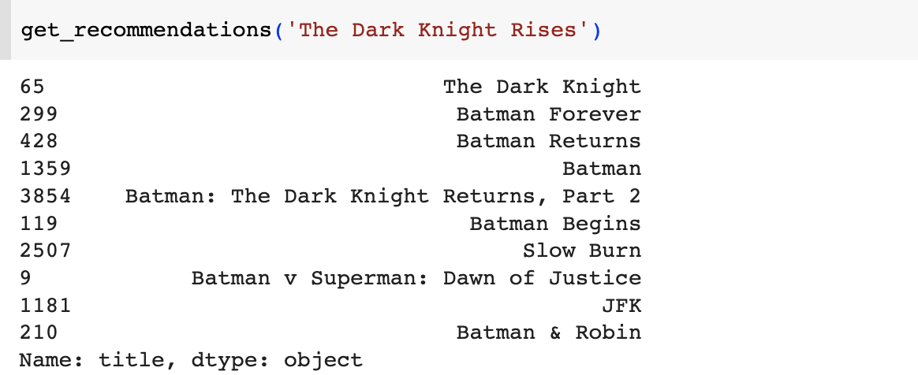
Result

Slide 12
Thank for listen
Name: Khuong Viet Tai
ID: 19522151

